Slide 1
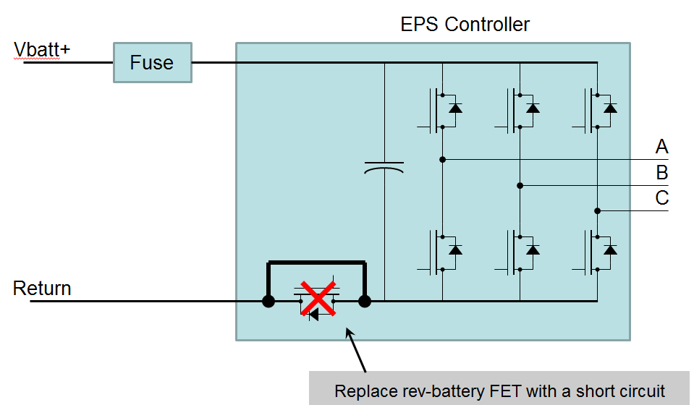
Remove Reverse-Battery Protection FET from EPS Control Modules
Description
Remove the reverse-battery protection FET from the EPS control module, and replace with a short circuit
Add local reverse-battery protection (diodes) at power supply and gate drive
For a reverse-battery condition, depend on the vehicle fuse to blow before an inverter FET is damaged
Risk: Inverter FET Damage
Fuses have huge variation in performance
An MTA MIDI fuse at 200% of current rating is guaranteed to blow somewhere between 3s and 100s
An MTA MIDI fuse at 500% of current rating is guaranteed to blow somewhere between 0.1s and 1.0s
Testing has shown that we can not depend on equal current sharing among the 3 legs of the inverter
Status
We are preparing to run PSA RA04 test on PSA BMPV controller (I. Amin and S. Muhammad)
Procuring test equipment (P. Bright)
Procuring more test powerpacks (Taoufik Hafid)
Getting clarification on the current pulse (amplitude and duration) (Cedric Rousset)
Work with NXP to interpret the test results and determine actual junction temperature (S. Muhammad)
Team Member/Customers
Pierre Longuemare (Paris), Cedric Rousset (Paris), Taoufik Hafid (Paris), Sadiq Muhammad, Ishtiaque Amin, Phil Bright

